Slide 1

CS 110 : Assembly Language and Programming Semester - 4

Slide 2
INTRODUCTION TO ASSEMBLY LANGUAGES
Sanskriti
Paridhi Sharma Geetika Sharma
Shreya Kashyap

Slide 3
Contents
Assembler
Opcode
Labels
Assembler Directives
Translation to machine code
Examples of assembly programs
Conclusion
Reference
Overview
Programming Languages & types
Compiler & Machine code
Limitation of machine languages
Assembly languages
Assembly v/s Machine Code
General format
Instructions

Slide 4
Overview
Assembly Language is a low-level programming language. In computers, there is an assembler that helps in converting the assembly code into machine code executable. Assembly language is designed to understand the instruction and provide it to machine language for further processing. It mainly depends on the architecture of the system, whether it is the operating system or computer architecture.
Assembly Language mainly consists of mnemonic processor instructions or data and other statements or instructions. Assembly Language helps in fine-tuning the program.

Slide 5

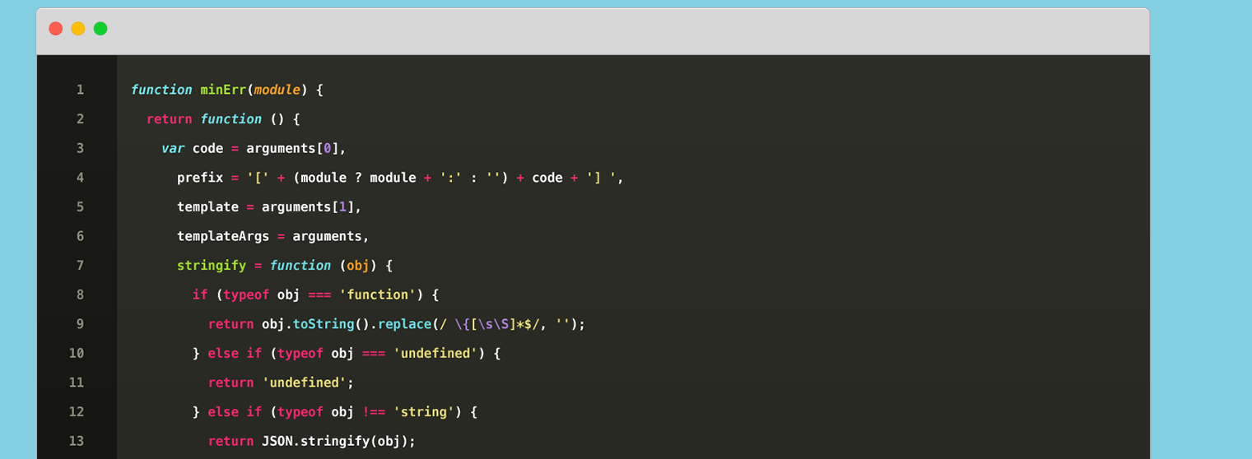
What is Language?
What is a Programming Language?
Language is a mode of communication that is used to share ideas, opinions with each other. For example, if we want to teach someone, we need a language that is understandable by both communicators.
A programming language is a computer language that is used by programmers (developers) to communicate with computers. It is a set of instructions written in any specific language ( C, C++, Java, Python) to perform a specific task.

Slide 6
Types of Programming Languages
Machine Language
Assembly Language
High Level Language
Considered a native language as it can be directly understood by a (CPU). It’s not so easy to understand, as the language uses the binary system in which the commands are written in 1 and 0 form which is not easy to interpret.
Low-level programming language in which there is a very strong correspondence between the instructions in the language and the architecture's machine code instructions.
Easy to understand and the code can be written easily as the programs written are user-friendly. The other advantage of code written is independent of a computer system The high-level of language uses the concept of abstraction

Slide 7
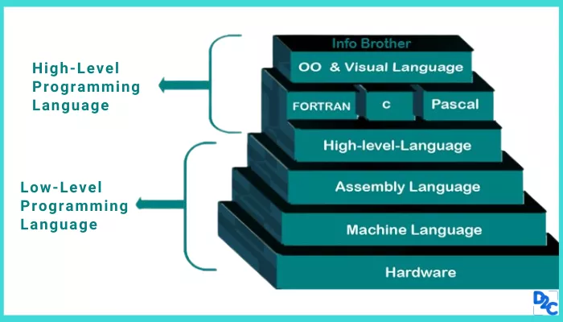
High-Level Language
Most programming now-a-days is done using so-called “high-level” languages (such as
FORTRAN, BASIC, COBOL, PASCAL, C, C++, JAVA, SCHEME, Lisp, ADA, etc.)

Slide 8
High-Level Language
"High-level language" refers to the higher level of abstraction from machine language. Rather than dealing with registers, memory addresses, and call stacks, high-level languages deal with variables, arrays, objects, complex arithmetic or boolean expressions, subroutines and functions, loops, threads, locks, and other abstract computer science concepts.
with strong abstraction from the details of the computer. it may use natural language elements, be easier to use, the amount of abstraction provided defines how "high-level" a programming language is

Slide 9
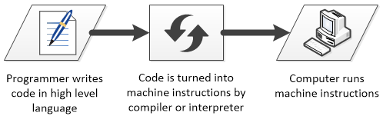
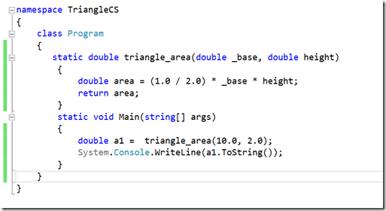


Slide 10
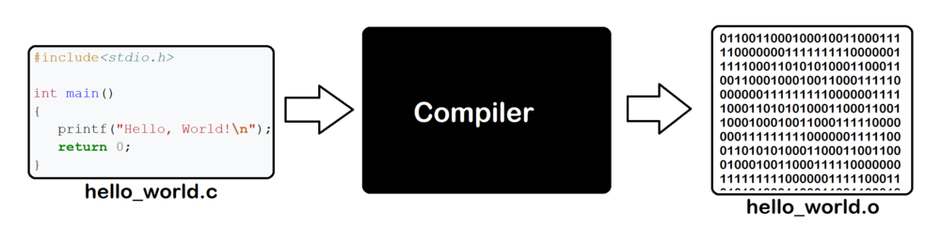
Compiler
A compiler is a special program that processes statements written in a particular programming language and turns them into machine language or "code" that a computer's processor uses. Typically, a programmer writes language statements in a language such as Pascal or C

Slide 11

Low-level programming language
Low-level language is machine-dependent (0s and 1s) programming language. The processor runs low- level programs directly without the need of a compiler or interpreter, so the programs written in low-level language can be run very fast
Low-level language is further divided
into two parts -
i. Machine Language
ii. Assembly Language

Slide 12
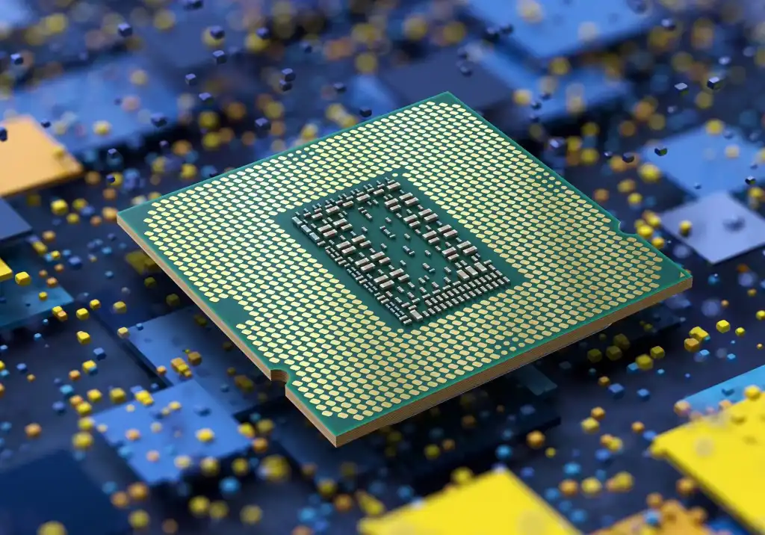
Machine code
Machine code, also known as machine language, is the elemental language of computers. It is read by the computer's central processing unit (CPU), is composed of digital binary numbers and looks like a very long sequence of zeros and ones.
Each CPU has its own specific machine language. The processor reads and handles instructions, which tell the CPU to perform a simple task. Instructions are comprised of a certain number of bits

Slide 13
If instructions for a particular processor are 8 bits, for example, the first 4 bits part (the opcode) tells the computer what to do and the second 4 bits (the operand) tells the computer what data to use.
0100 1110 -> ADD 14 -> AC <- AC + 14
Example of 32 bit instructions
01001000 00110101 01101100 01101100
The 32-bit instruction may have six fields: cond, op, funct, Rn, Rd, and Src2. The operation the instruction performs is encoded in the field: op (also called the opcode or operation code) and funct or function code; the cond field encodes conditional execution based on flags

Slide 14
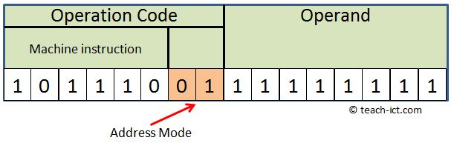
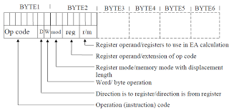
Depending upon the processor, a computer's instruction sets may all be the same length, or they may vary, depending upon the specific instruction
The architecture of the particular processor determines how instructions are patterned

Slide 15
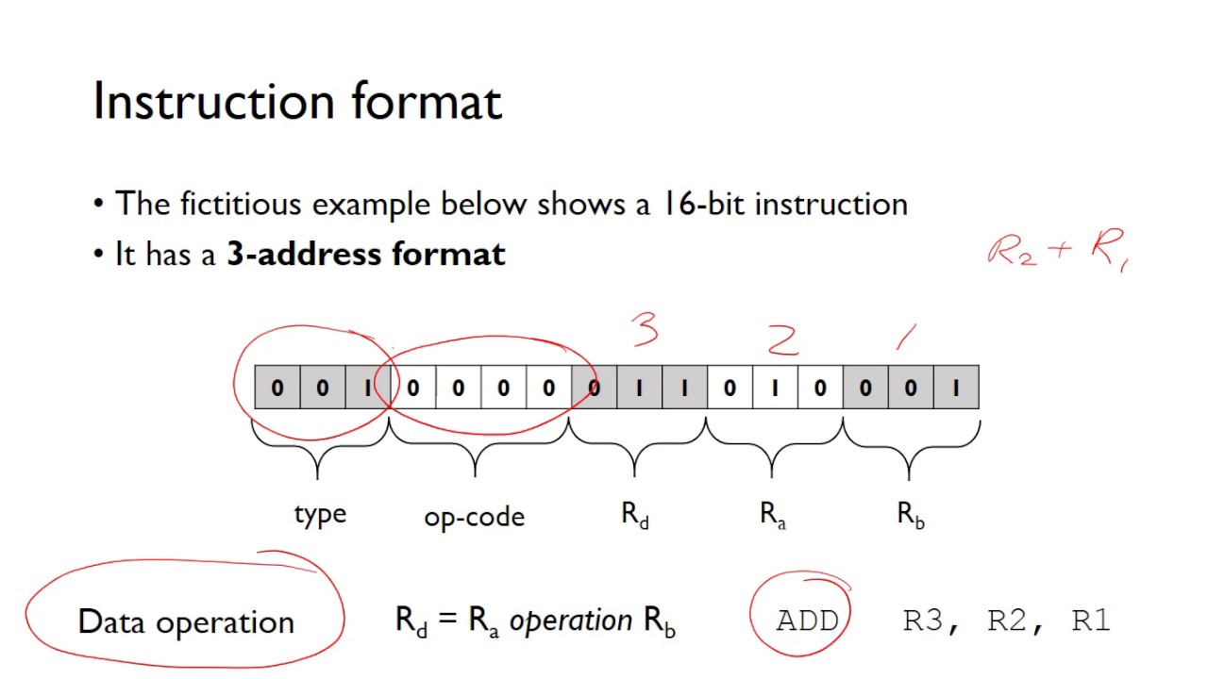

Slide 16
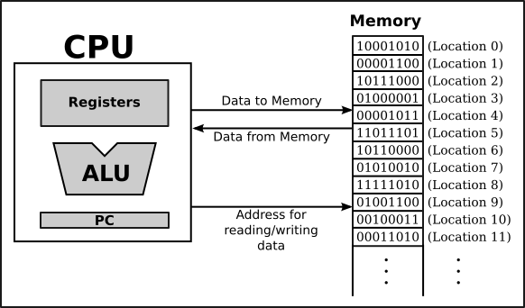
How Does CPU execute these?

Slide 17
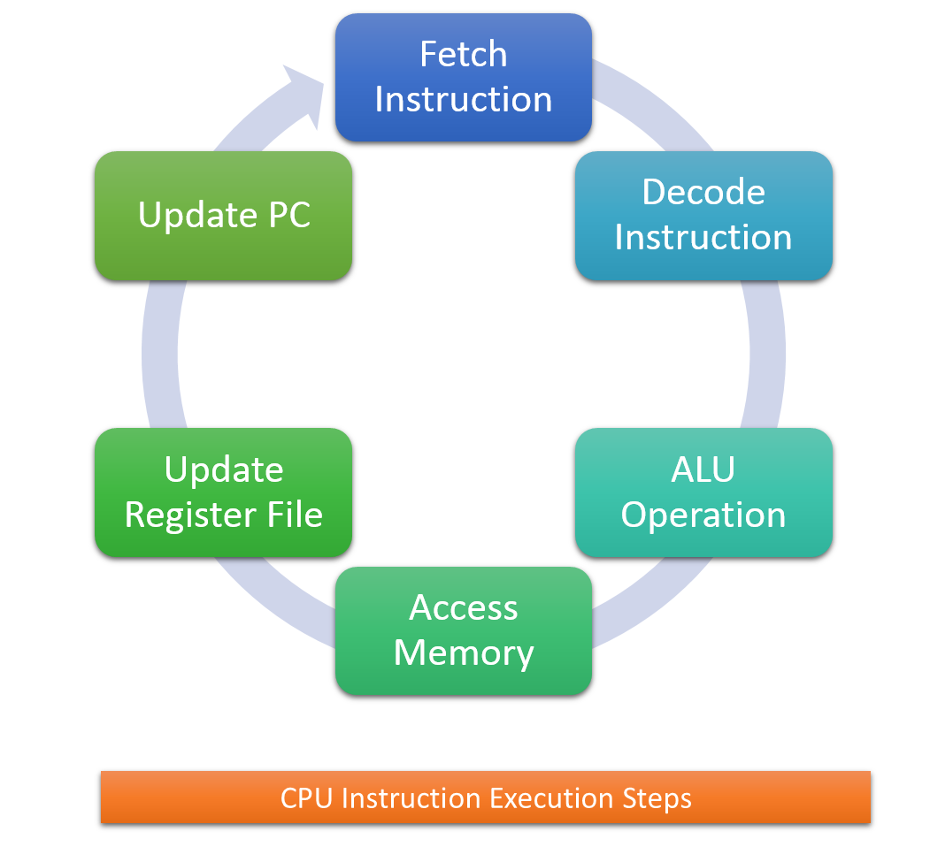
The Fetch and Execute Cycle

Slide 18
Limitation of Machine language
Solution ? We move on to the Assembly Language
It is machine dependent i.e. it differs from computer to computer.
It is difficult to program and write.
It is prone to errors
It is difficult to modify.

Slide 19
Assembly language
It is a low level programming language that allows a user to write a program using alphanumeric mnemonic of instructions. It requires a translator as assembler to convert language into machine language so that it can be understood by the computer.
It is easier to remember and write than machine language.

Slide 20

Advantage(s)
Advantage(s) of using assembly language rather than machine language is/are:
A. It is mnemonic and easy to read
B. Addresses any symbolic, not absolute
C. Introduction of data to program is easier
D. easy to locate and correct errors.

Slide 21
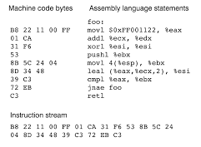
Assembly vs Machine Code

Slide 22
Key Ideas
There are two key ideas:
-- mnemonic opcodes: we use abbreviations of English language words to denote operations
-- symbolic addresses: we invent “meaningful” names for memory storage locations we need
These make machine-language understandable to humans – if they know their machine’s design
Let’s see our example-program, rewritten using actual “assembly language” for Intel’s Pentium

Slide 23
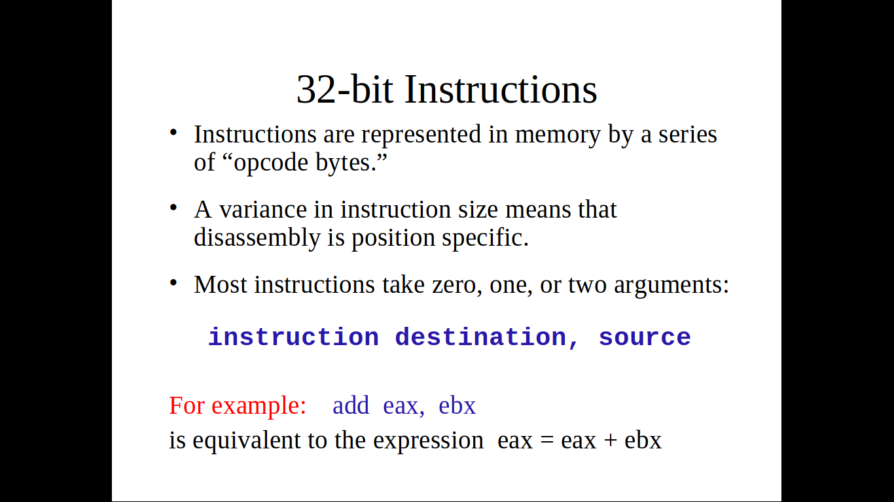

Slide 24
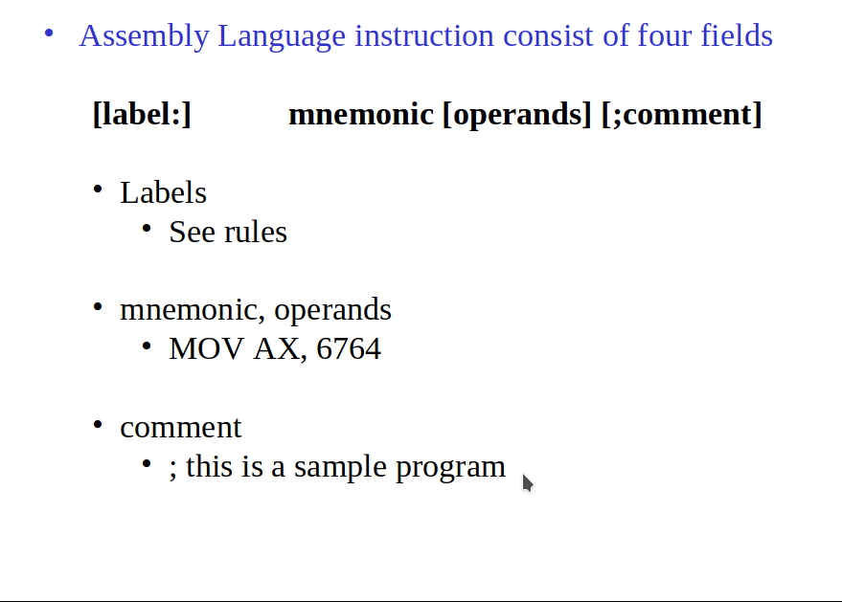
Assembly Programming

Slide 25
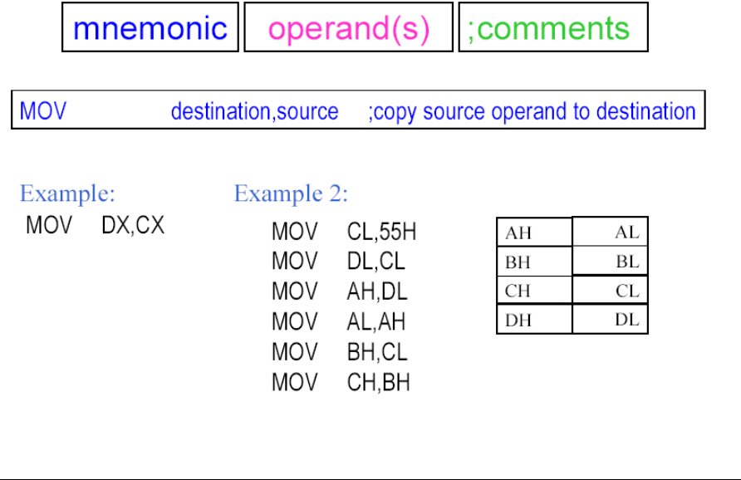
General Format

Slide 26
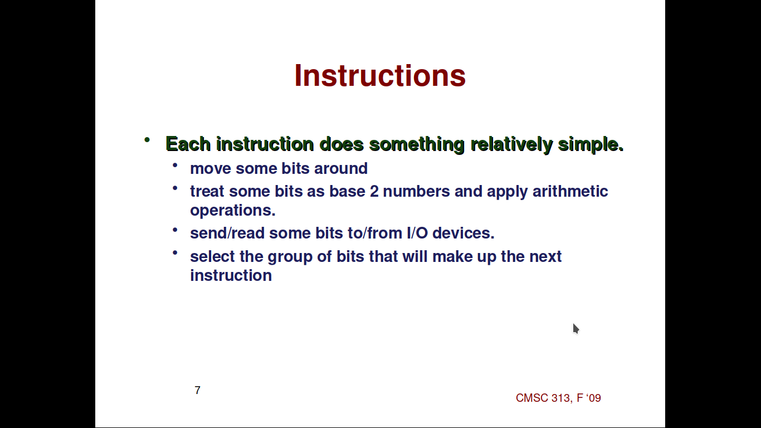
Instructions

Slide 27
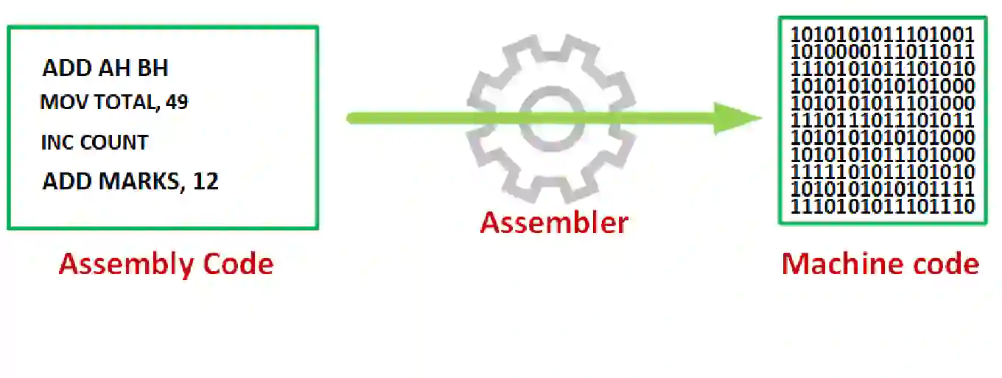
Assembler
It is a computer programme which converts or translate assembly language into machine language. It assembles the machine language program in the main memory of the computer and makes it ready for execution.

Slide 28
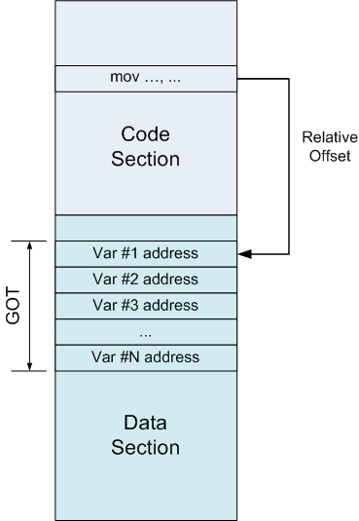
Basic Assembly Program
An assembly program can be divided into
three sections −
The data section,
The stack section, and
The text section.

Slide 29
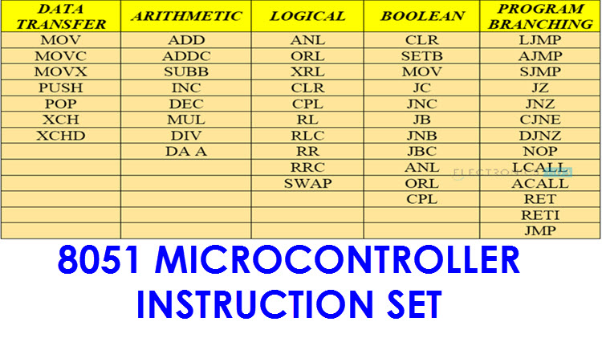
Opcode
In computing, an opcode (abbreviated from operation code, also known as instruction machine code, instruction code, instruction syllable, instruction parcel or opstring) is the portion of a machine language instruction that specifies the operation to be performed.

Slide 30
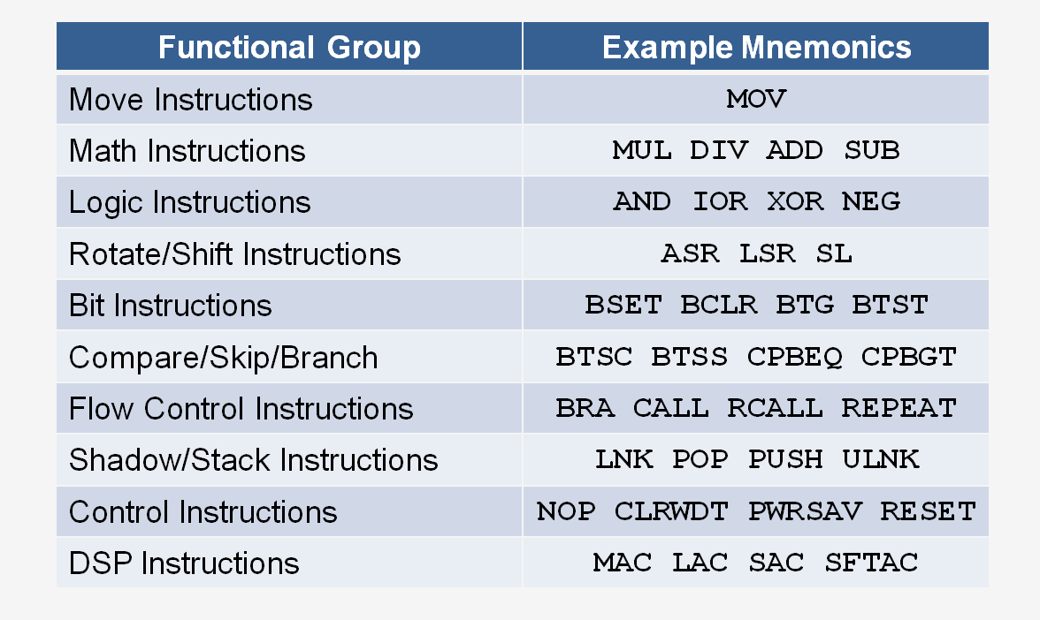

Slide 31
Labels
A label can be placed at the beginning of a statement. During assembly, the label is assigned the current value of the active location counter and serves as an instruction operand.
Acts as a place marker
There are two types of lables: symbolic and numeric

Slide 32
Assembler Directives
Assembler directives are the instructions used by the assembler at the time of assembling a source program.
More specifically, we can say, assembler directives are the commands or instructions that control the operation of the assemble

Slide 33
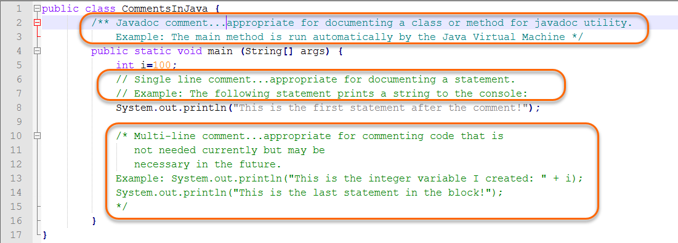
Comments
In computer programming, a comment is a programmer-readable explanation or annotation in the source code of a computer program. They are added with the purpose of making the source code easier for humans to understand, and are generally ignored by compilers and interpreters

Slide 34
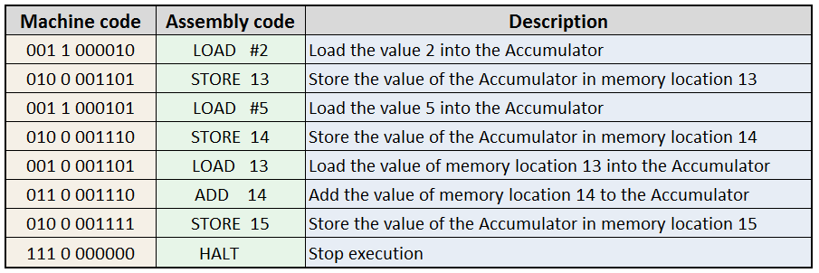
Assembly translates to Machine Code

Slide 35
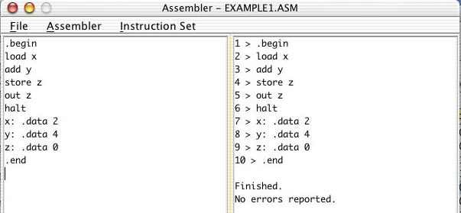
Example assembly program

Slide 36
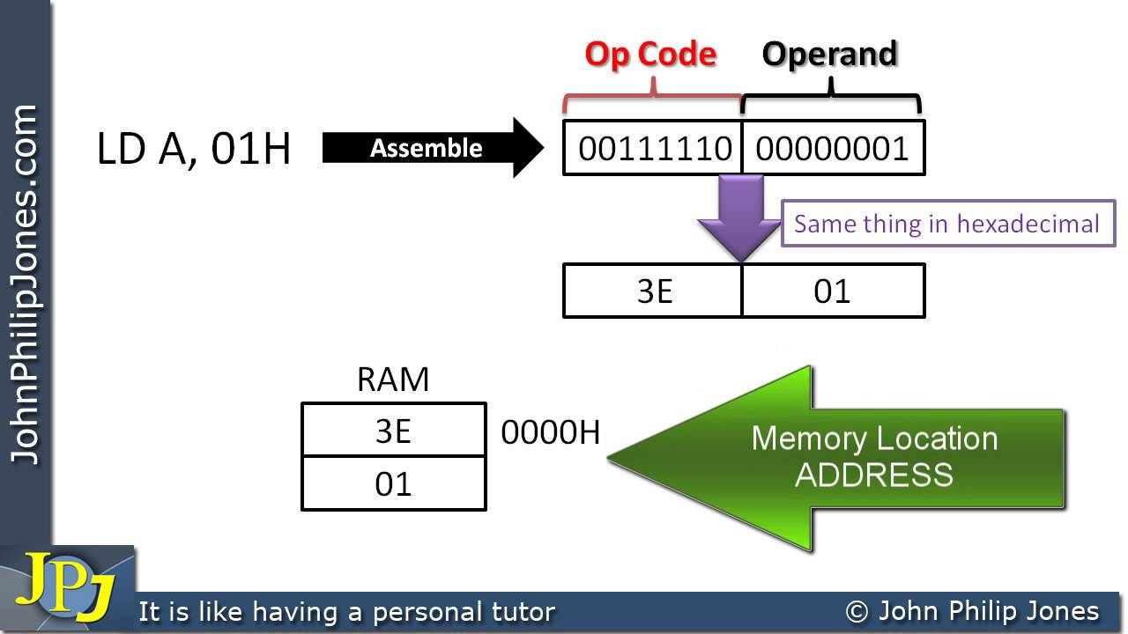
Interpreting an Assembly Instruction
To interpret machine language, one must decipher the fields of each instruction word. Suppose there is a 32 bit instruction, different instructions use different formats, but all formats start with a 6-bit opcode field. Thus, the best place to begin is to look at the opcode. If it is 0, the instruction is R-type; otherwise it is I-type or J-type.

Slide 37
Translating Memory Instructions into Machine Language
Example, Translate the following assembly language statement into machine language.
STR R11, [R5], #-26
STR is a memory instruction, so it has an op of 012. According to Table 6.11, L = 0 and B = 0 for STR. The instruction uses post-indexing, so according to Table 6.10, P = 0 and W = 0. The immediate offset is subtracted from the base, so I = 1 and U = 0. shows each field and the machine code. Hence, the machine language instruction is 0xE405B01A.

Slide 38

When do we use Assembly
Assembly-level programming is still written, and fairly often, as well.
The most traditional groups of people who write assembly are compiler and OS programmers, but it’s also used in a wide swath of other applications
It’s used in:
Certain parts of video games
Certain parts of virtual machines
Most automobile software
A lot of embedded systems

Slide 39
Disadvantages of Assembly Language
Disadvantages Assembly Language:
1. One of the major disadvantages is that assembly language is machine dependent. A program written for one computer might not run in other computers with different hardware configuration.
2. Long programs written in such languages cannot be executed on small sized computers.
3. It takes lot of time to code or write the program, as it is more complex in nature.

Slide 40
Conclusion : Assembly Language
An assembly language is a type of programming language that translates somewhat english like mnemonics and addresses directly into machine language.
It is a necessary bridge between software programs and their underlying hardware platforms.
Today, assemble languages are rarely written directly, although they are still used in some niche applications such as when performance requirements are particularly high.

Slide 41
Reference
https://www.codecademy.com/learn/computer-architecture/modules/assembly-language
https://www.tutorialspoint.com/assembly_programming/index.htm
https://github.com/Sarvesh-CSE/Computer_Organization
https://www.massey.ac.nz/~mjjohnso/notes/59102/notes/l9.html

Slide 42

Thank You

